Slide 1
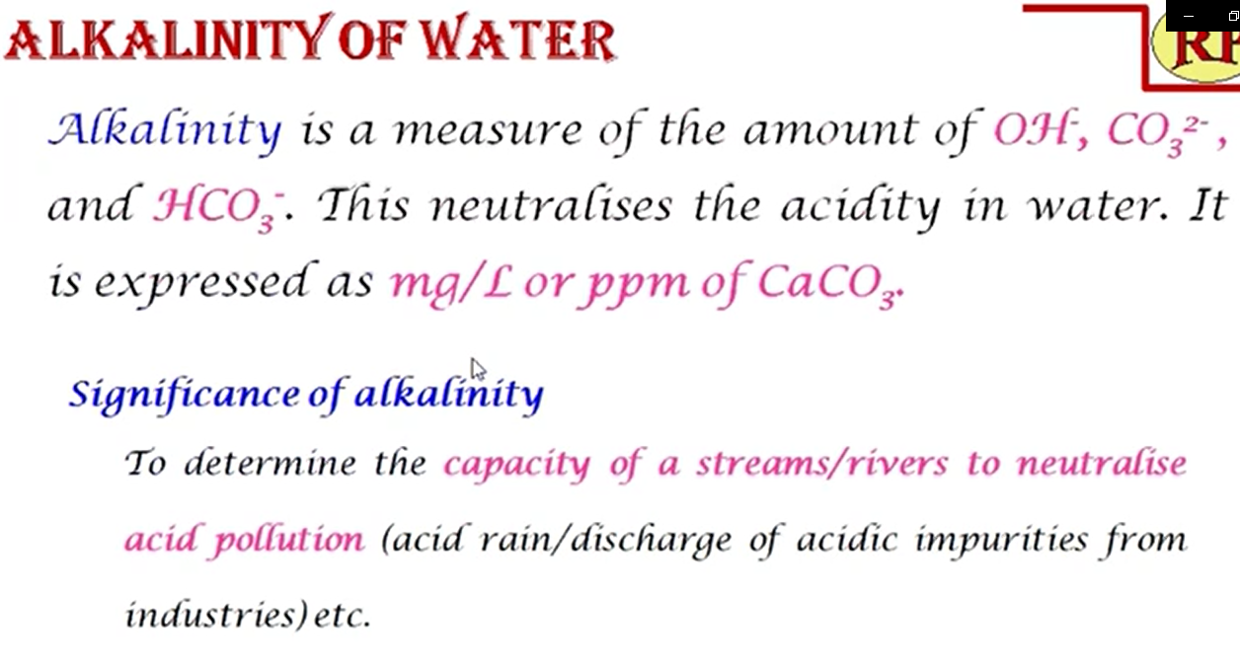

Slide 2


Slide 3
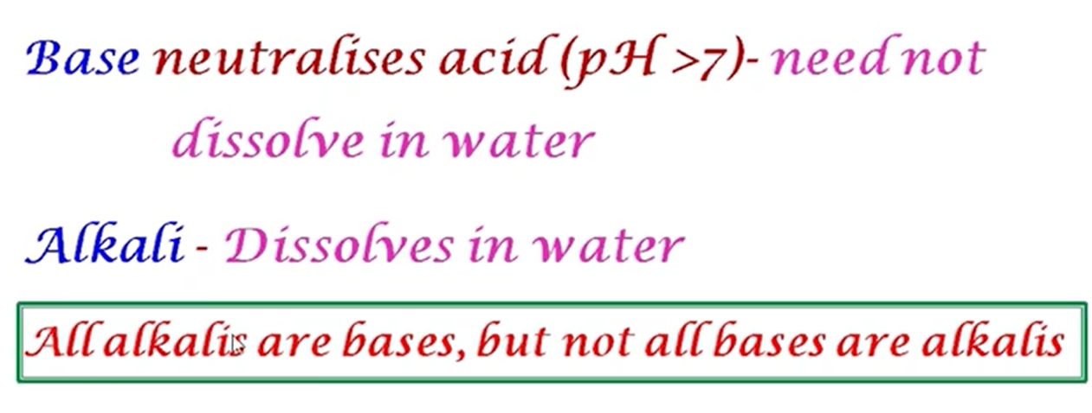

Slide 4
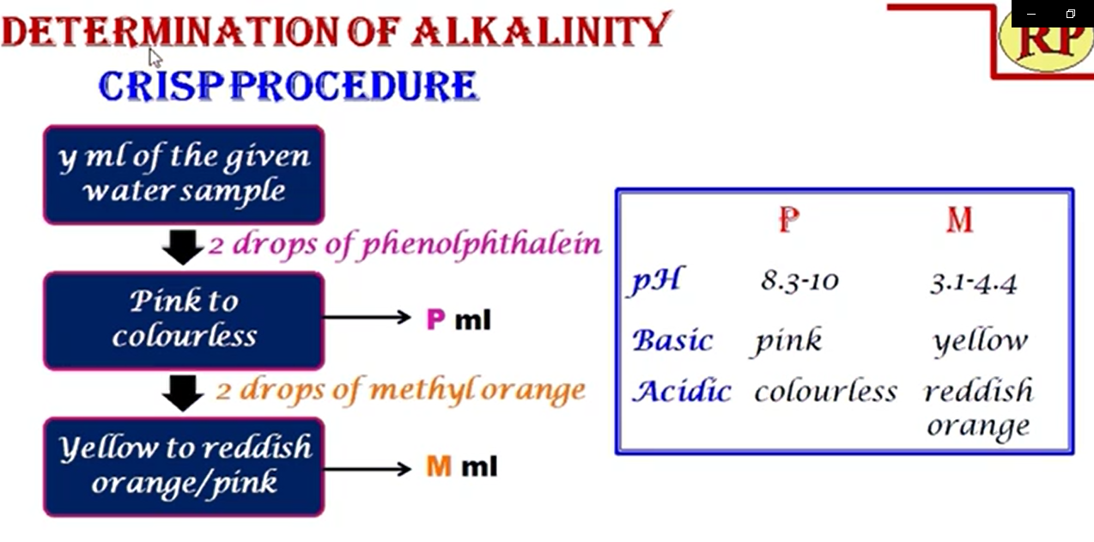

Slide 5
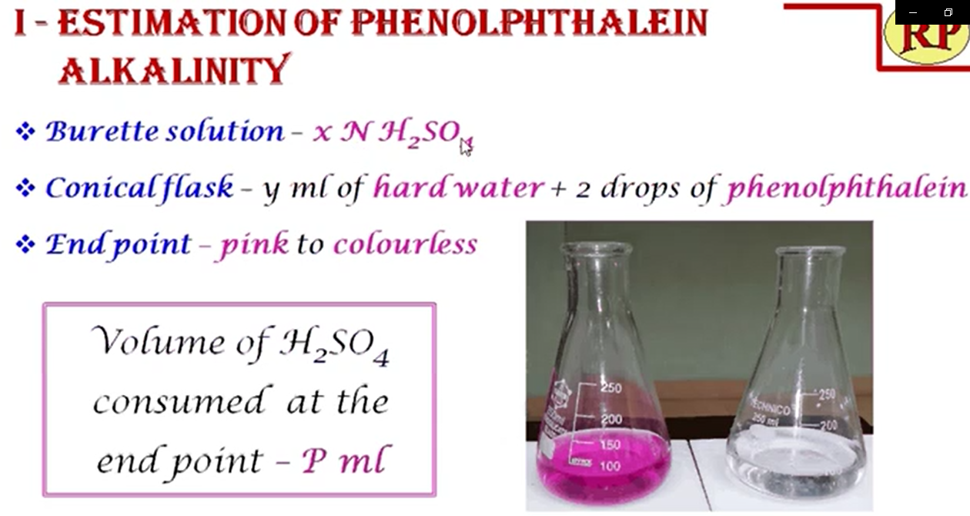

Slide 6
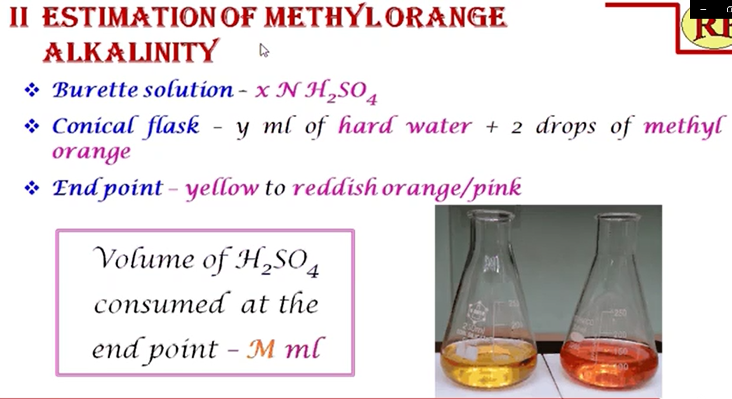

Slide 7
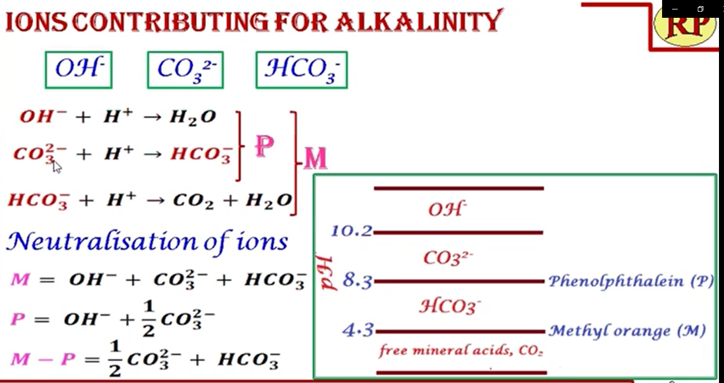

Slide 8
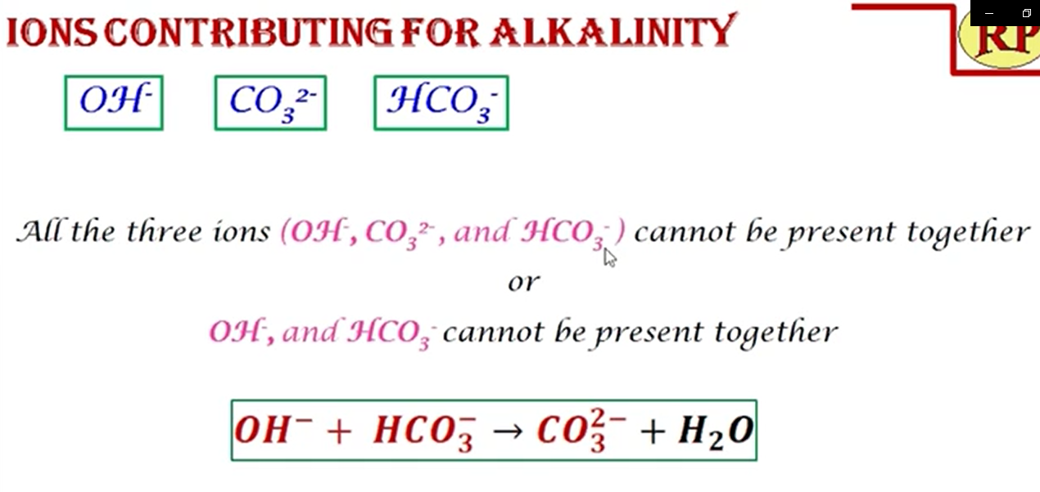

Slide 9
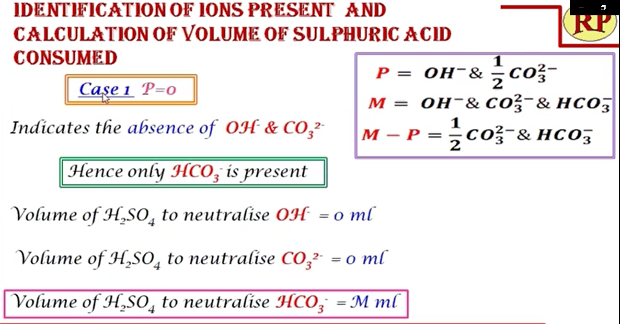

Slide 10
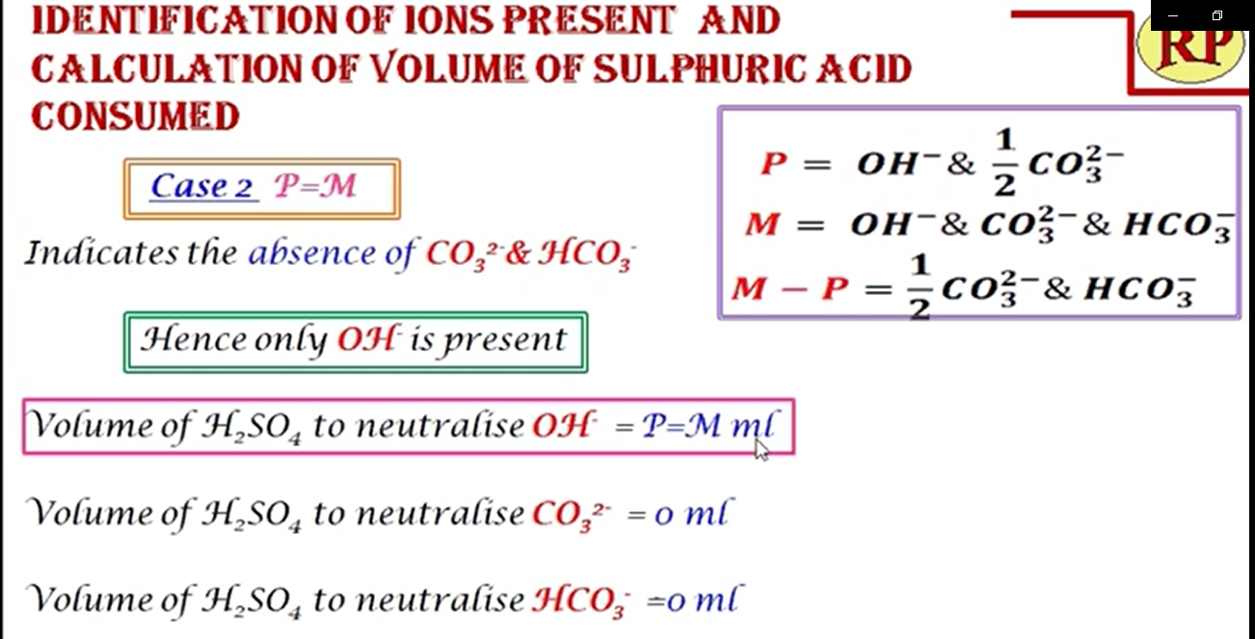

Slide 11
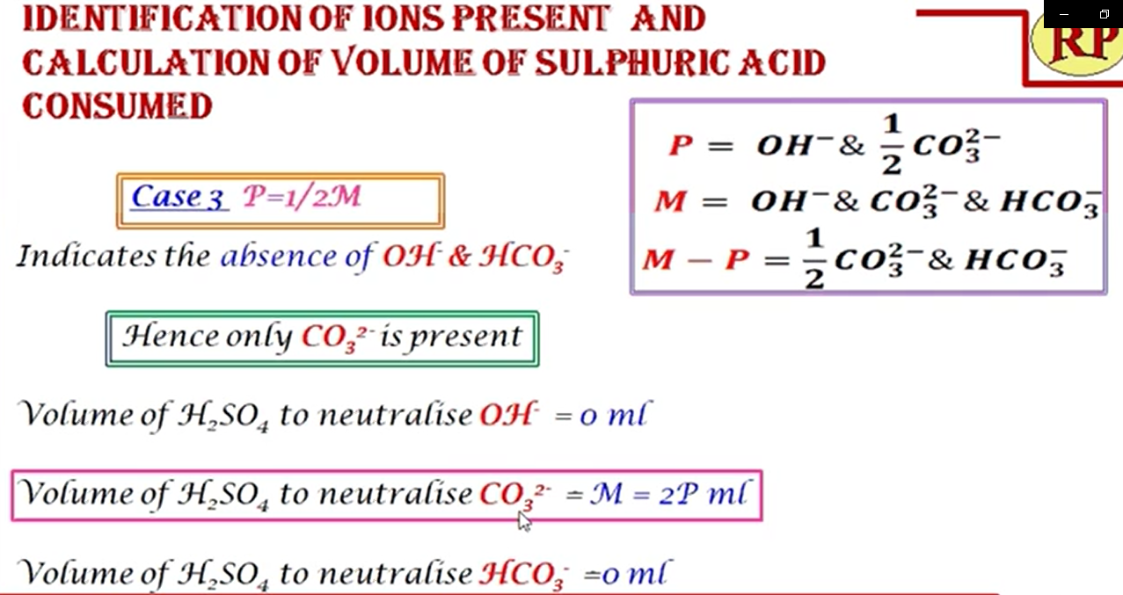

Slide 13
Problem:
50 mL of a sample of water required 5 mL of N/50 H2SO4 using methyl orange as indicator but did not give any coloration with phenolphthalein. What kind of alkalinity is present (ppm)?

Slide 14
Solution:
As water does not give any coloration with Ph, So P = 0
Hence, only HCO₃⁻ ions are present.
Now, 50 mL of H2O sample upto MO end point = 5 ml of N/50 H2SO4
50 mL x N_{M} = 5 mL x N/50; thus N_{M} = 1/500 N
Now, strength of alkalinity upto MO end point
(in terms of CaCo3 equivalent = (N_{M} x 50) g/L
M= 1/500 x 50 g/L x 1000
M = 100 mg/L = 100 ppm
Hence, alkalinity due to HCO3⁻ = M = 100 ppm

Slide 15
Problem:
200 mL of water sample on titration with N/50 H2SO4 using Ph indicator gives the end point when 10 mL of acid were run down. Another lot of 200 mL of the sample also required 10 mL of the acid to obtain MO end point. What kind of alkalinity is present in the sample and what is its magnitude?

Slide 16
Solution:
200 mL of H2O upto Ph end point = 10 mL of N/50 H2SO4
200mL x Np = 10 mL x N/50
Or Normality = 10 mL x 1/50 x 1/200 = 1/1000N
Hence P = Np x 50 x 1000 ppm
= 1/1000 X 50 X 1000 = 50 PPM
Similarly M = 50 ppm
P = M
Hence, OH- ions are present, thus alkalinity of OH- = 50 ppm

